Slide 1
Genomic Prediction with TCGA Data
Classification models for the detection of lung adenocarcinoma
Ting Shen and Scott Funkhouser
STT 855 Final Project

Slide 2
Overview
Motivation for studying lung adenocarcinoma
Review what has been done previously with lung-adenocarcinoma data.
Classification of tissue (normal vs tumor) using candidate CNV vs whole genome approach.
Conclusions

Slide 3
Motivation to study lung adenocarcinoma
Lung cancer is the most common cause of cancer-related mortality world-wide.
1M deaths/year
Lung adenocarcinoma is the most common type of lung cancer.
Many lung adenocarcinomas lack an identifiable “driver” genes.
Häggström, Mikael (2014). "Medical gallery of Mikael Häggström 2014". Wikiversity Journal of Medicine 1 (2).

Slide 5
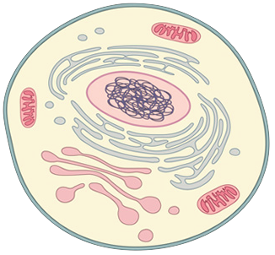
230 lung-adenocarcinoma patients
Tumor tissue and normal tissue taken from each patient.
Data from each tissue was collected:
DNA sequencing (whole exome sequencing)
mRNA sequencing
microRNA sequencing
Copy number array
Methylation array
Protein array
GOAL:
Determine molecular pathogenesis of lung adenocarcinoma.
Provide the foundation for classifying the disease.
Tumor tissue
Normal tissue

Slide 6
Biology review
Central dogma
Copy number variants (CNV)
methylation
mircoRNAs

Slide 7
Identification of “significantly mutated” genes
Determines probability that the number of observed mutations exceed the expected background mutation rate (BMR).
MutSigCV Algorithm

Slide 8
Tumor suppressor, “Guardian of the genome”
Proto-Oncogene, tissue signaling
Stress sensing
Tumor suppressor, cell polarity
Proto-Oncogene, cell proliferation
Tumor suppressor, regulates RAS pathway
Tumor suppressor, regulates RAS pathway
Tumor suppressor, histone methyltransferase
RNA binding protein
Transcription factor
Oncogene, growth factor receptor
Alters chromatin structure
Oncogene, signaling cascade
Alters chromatin structure
Tumor suppressor, transcriptional repressor
Tumor suppressor, cell cycle regulator
Splicing
Response to stress
A <-> C
G <-> T
A <-> G
C <-> T
insertions
deletions

Slide 9
Association between DNA mutations and RNA

Slide 10
Candidate somatic CNV’s identified with GISTIC
Sample Set | Type | Cytoband | q value | Residual q value | Wide peak boundaries | Number of genes in peak | Top candidate genes in wide peak
All Samples (n=230) | Amplification | 14q13.3 | 2.27E-26 | 2.27E-26 | chr14:36854137-37023019 | 2 | NKX2-1
All Samples (n=230) | Amplification | 8q24.21 | 1.70E-17 | 1.88E-17 | chr8:129157821-129195260 | 0 | -
All Samples (n=230) | Amplification | 5p15.33 | 8.89E-16 | 4.69E-14 | chr5:1288616-1300024 | 1 | TERT
All Samples (n=230) | Amplification | 12q15 | 2.78E-16 | 7.42E-13 | chr12:69212011-69485451 | 2 | MDM2
All Samples (n=230) | Amplification | 1q21.3 | 7.21E-10 | 7.21E-10 | chr1:120523956-152743148 | 166 | MCL1
All Samples (n=230) | Amplification | 12p12.1 | 1.33E-05 | 1.51E-05 | chr12:25402469-26433911 | 6 | KRAS
All Samples (n=230) | Amplification | 20q13.33 | 1.58E-07 | 2.00E-05 | chr20:62090554-63025520 | 36 | -
All Samples (n=230) | Amplification | 7p11.2 | 1.52E-05 | 7.09E-05 | chr7:54535672-55737616 | 6 | EGFR
All Samples (n=230) | Amplification | Xq28 | 0.00031917 | 0.00031917 | chrX:153306080-155270560 | 52 | -
All Samples (n=230) | Amplification | 7q31.2 | 0.00059128 | 0.00059128 | chr7:116283302-116449049 | 1 | MET
All Samples (n=230) | Amplification | 3q26.2 | 0.00068905 | 0.00068905 | chr3:168804384-170787300 | 20 | TERC
All Samples (n=230) | Amplification | 19q13.11 | 0.0024887 | 0.0024887 | chr19:29099880-38092168 | 143 | -
All Samples (n=230) | Amplification | 11q13.3 | 0.0026573 | 0.0026573 | chr11:68745684-69587582 | 7 | CCND1
All Samples (n=230) | Amplification | 6p21.1 | 0.011819 | 0.011819 | chr6:37381636-42861797 | 59 | CCND3
All Samples (n=230) | Amplification | 12q14.1 | 6.62E-09 | 0.017674 | chr12:58038861-58369932 | 14 | CDK4
All Samples (n=230) | Amplification | 17q12 | 0.005914 | 0.019017 | chr17:37804811-38011853 | 8 | ERBB2
All Samples (n=230) | Amplification | 5p13.2 | 5.05E-05 | 0.04864 | chr5:33498056-50133375 | 71 | -
All Samples (n=230) | Amplification | 17q25.3 | 0.039508 | 0.073911 | chr17:47675684-81195210 | 417 | CDK3
… | … | ... | ... | ... | … | … | …

Slide 11
From 518 lung-adenocarcinoma patients
“Gene based” normalized CNV data from 590 normal tissues and 551 tumor tissues
From 516 lung-adenocarcinoma patients
Normalized gene expression values from 59 normal tissues and 517 tumor tissues

Slide 12
“Gene based” CNV data
24959 parameters in total. One for each gene.
 | GJA9 | RHBDL2 | AKIRIN1 | NDUFS5 | MACF1 | KIAA0754 | …
TCGA-49-4507-11A-01D-1204-01 | 0.0023 | 0.0023 | 0.0023 | 0.0023 | 0.0023 | 0.0023 | …
TCGA-55-6981-11A-01D-1943-01 | -0.0014 | -0.0014 | -0.0014 | -0.0014 | -0.0014 | -0.0014 | …
TCGA-44-2657-11A-01D-1877-01 | 0.0026 | 0.0026 | 0.0026 | 0.0026 | 0.0026 | 0.0026 | …
TCGA-55-6983-11A-01D-1943-01 | -0.0006 | -0.0006 | -0.0006 | -0.0006 | -0.0006 | -0.0006 | …
TCGA-78-7143-10A-01D-2035-01 | -0.0142 | -0.0142 | -0.0142 | -0.0142 | -0.0142 | -0.0142 | …
TCGA-44-6144-01A-11D-1752-01 | 0.9845 | 0.9845 | 0.9845 | 0.9845 | 0.9845 | 0.9845 | …
TCGA-55-8514-10A-01D-2389-01 | 0 | 0 | 0 | 0 | 0 | 0 | …
TCGA-44-3919-11A-01D-1877-01 | 0.0027 | 0.0027 | 0.0027 | 0.0027 | 0.0027 | 0.0027 | …
… | … | … | … | … | … | … | …

Slide 13
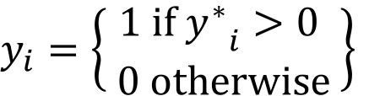
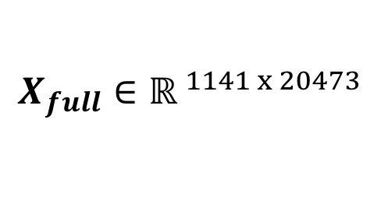
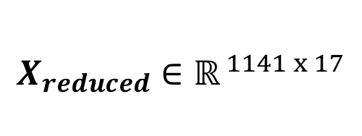
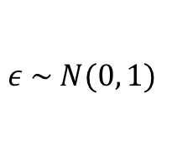
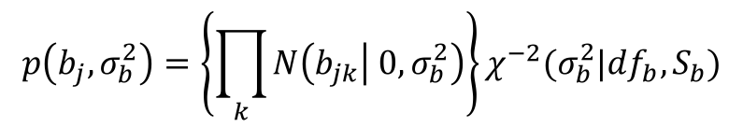
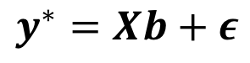
The classification model
Probit link function
Goal: To predict tumor status (binary outcome) from full and reduced CNV model
$$y^{∗}=Xb+ε$$
Model fit using “Bayesian Ridge Regression”
$y_{i}=\left\{\left.\begin{aligned}1 if {y^{∗}}_{i}>0 \\ 0 otherwise\end{aligned} \right\}\right.$
$$p\left(b_{j},σ_{b}^{2}\right)=\left\{\prod_{k}{N\left(b_{jk} | 0,σ_{b}^{2}\right)}\right\}χ^{−2}(σ_{b}^{2}|df_{b},S_{b})$$
$$ε \sim N(0, 1)$$
Reduced model – using 17 candidate CNVs
$$X_{reduced}∈ℝ^{ 1141 x 17}$$
Randomly select 200 individuals for testing (TST group).
Remainder are used to train the model (TRN group).
Full model – using all CNVs
$$X_{full}∈{ℝ }^{1141 x 20473}$$

Slide 14
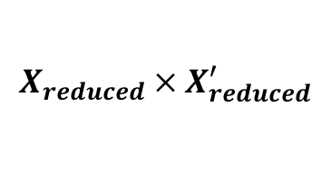
Reduced model (p = 17)
Eigendecomposition of
$$X_{reduced} × X_{reduced}^{′}$$

Slide 15
Reduced model (p = 17)
Gibbs sampling of posterior
10000 iterations
2000 burn-in
2 thinning

Slide 16
Reduced model (p = 17)

Slide 17
Full model (p = 20473)

Slide 18
Potential future goals
Can the variation observed in tumor CNV or tumor gene expression predict patient outcomes?
Response to therapy
Survival
http://www.danafarberbostonchildrens.org

Slide 19
Conclusions
While lung adenocarcinoma may be complex in that many different pathways can lead to the same disease, cancer status can be predicted when regressed upon just a few predictors.
Variants of large effect such as proto-oncogenes and tumor suppressors enable this.
TCGA is a treasure-trove of data! Methylation, splice-junction expression values, isoform expression values, etc. can be downloaded with TCGA-Assembler

